Slide 1


Infosys Springboard 5.0
EVENT MANAGEMENT SYSTEM
Effortlessly manage and book events with a user-friendly platform using Flask and Mysql
Team No: 1
Mentor : A. Abhinaya

Slide 2

INTRODUCTION
This platform streamlines event management by simplifying event creation, ticket booking, and venue coordination. Key features include flexible location selection, smart scheduling to avoid conflicts, and secure user authentication. It replaces manual tasks with a seamless, efficient system, offering both users and admins the tools to manage events and bookings with ease and accuracy.

Slide 3
PROBLEM STATEMENT
In modern event planning, managing event creation, ticket booking, and venue coordination can be a complex and time-consuming process. Traditional methods often involve manual scheduling, location management, and registration, leading to inefficiencies, conflicts, and errors.
These outdated systems can delay operations and result in a poor user experience. With the growing need for streamlined workflows and real-time updates, there is a demand for a solution that automates event management, ensuring seamless coordination, accurate scheduling, and smooth booking while providing a user-friendly and scalable platform for both organizers and attendees.

Slide 4





ABSTRACT
Provides a customer portal for event browsing, booking, payments, and viewing bookings.
Includes an admin portal for managing events, customer details, and appointments.
Features a notification system to keep customers updated on event changes.
Simplifies event-related processes for both customers and administrators.
Ensures efficient and organized event management.

Slide 5
TEAM MEMBERS
Abhisha Hedge
Piyush Raj
Ashish Jha
Thejasvi

Slide 6

PROJECT
ROADMAP

Slide 7
TECHNOLOGY STACK
●Backend : Flask, SQLAlchemy
●Frontend : HTML, CSS, JavaScript, Bootstrap
●Database : MySQL
●Tools : Git, VS Code
●Hosting : Flask Local Server

Slide 8





USE
CASE
DIAGRAM
Register
Login
Add event
Managing
functions
Book Tickets
ADMIN
USER
Secure Payment
Receive Notification

Slide 9
CHALLENGES AND SOLUTIONS
1.
Challenge: Handling overlapping event
schedules effectively.
Challenge: Integrating real-time notifications
for users.
Solution:
Use a simple scheduling algorithm to check and prevent overlapping event times.
2.
Solution:
Simulate notifications by displaying messages or alerts within the application.
3.
Challenge: Ensuring secure authentication
and payment processing.
Solution:
Implementing a secure username based login system, seamless process for booking venues.
Challenge: Send customizable notifications to particular user.
4.
Solution:
Provide customizable notifications via a dropdown to select users and a message field.
Challenge: Ability to set appointment
5.
Solution:
Add a static appointment scheduling feature using form inputs and stored data.

Slide 10
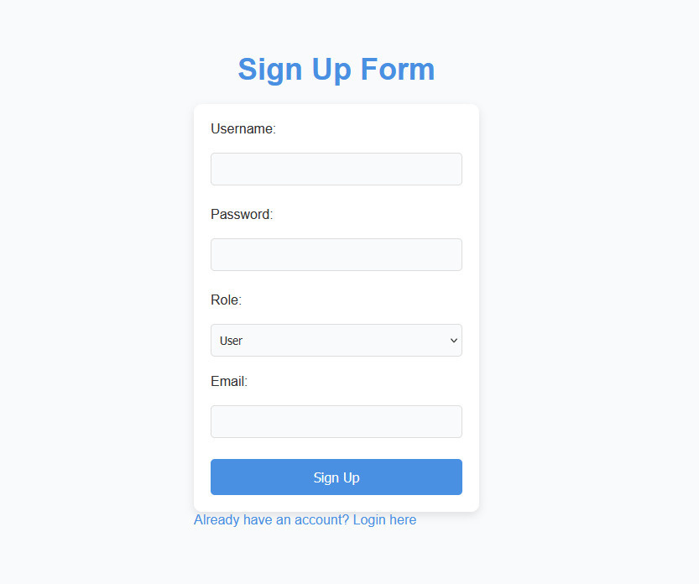

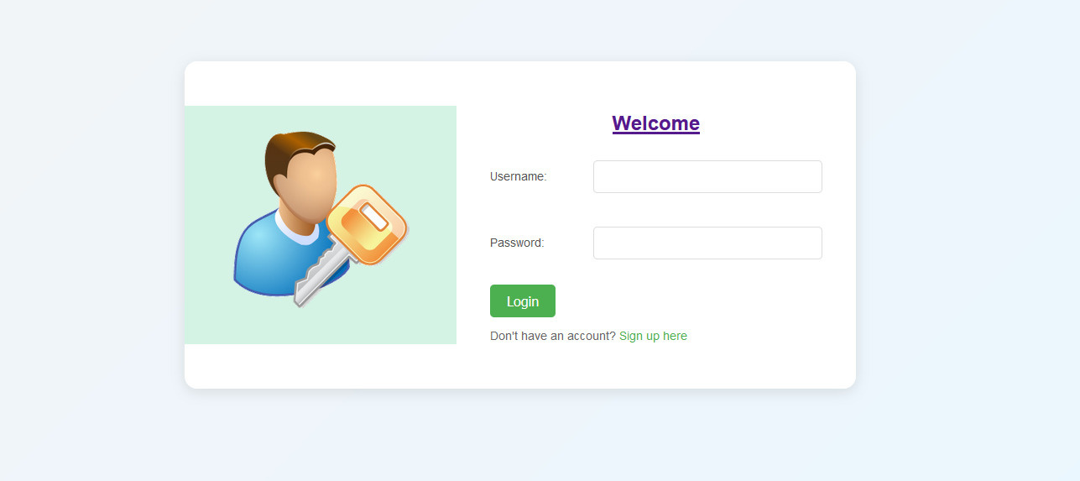
CUSTOMER SIDE
LOGIN AND SIGNUP

Slide 11
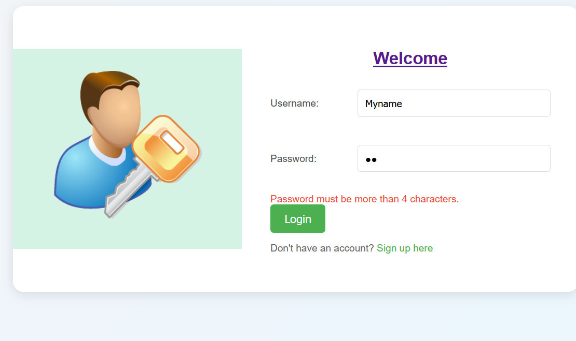
VALIDATION USED

Slide 12
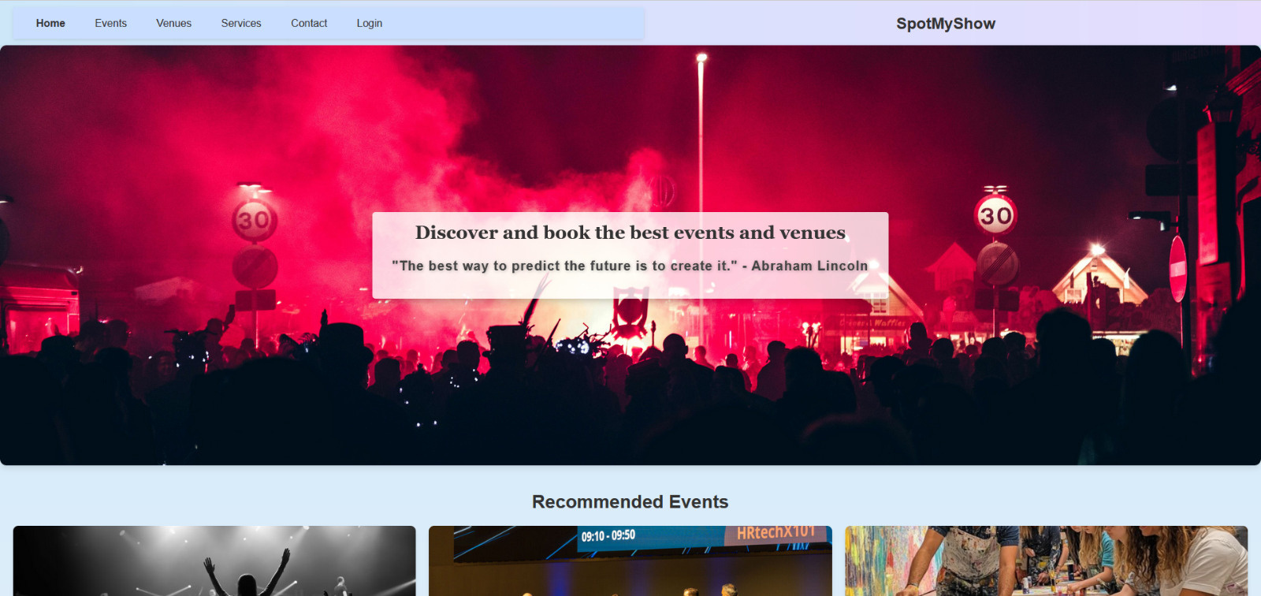
HOME PAGE

Slide 13
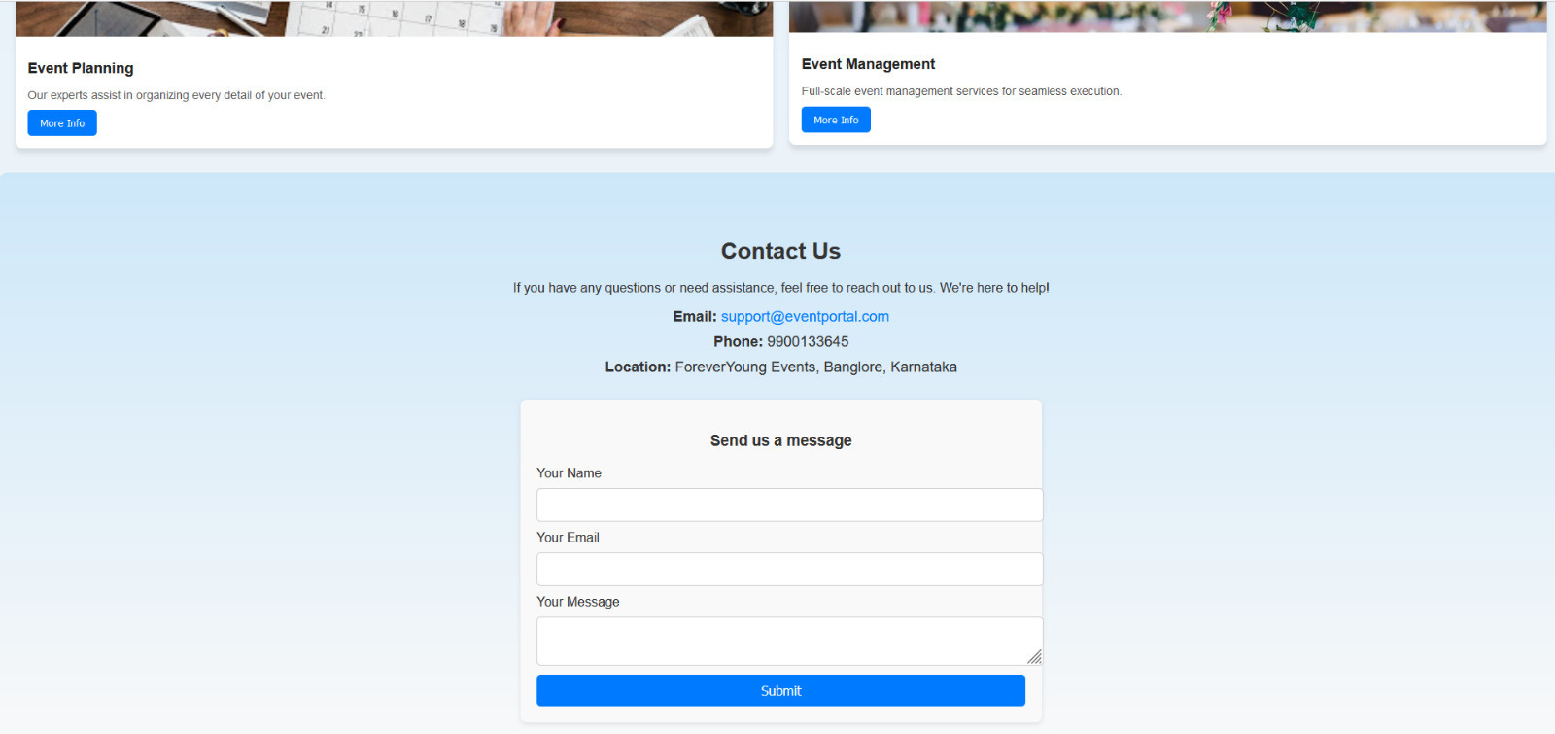
CONTACT US

Slide 14
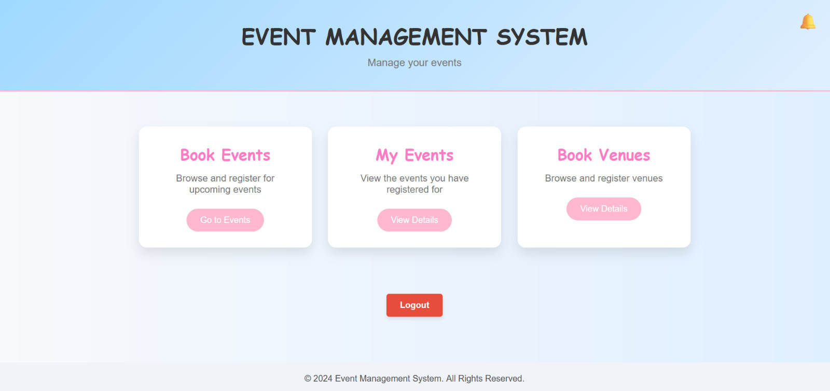
USER DASHBOARD

Slide 15
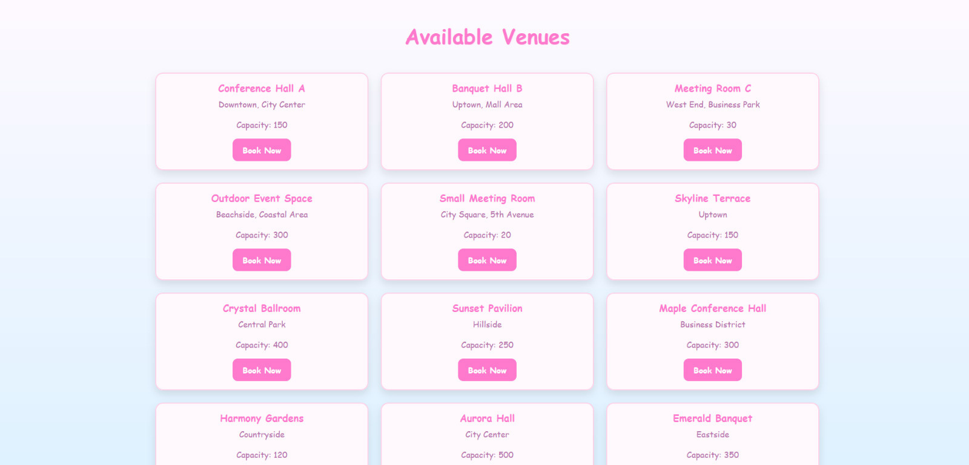
VENUES

Slide 16
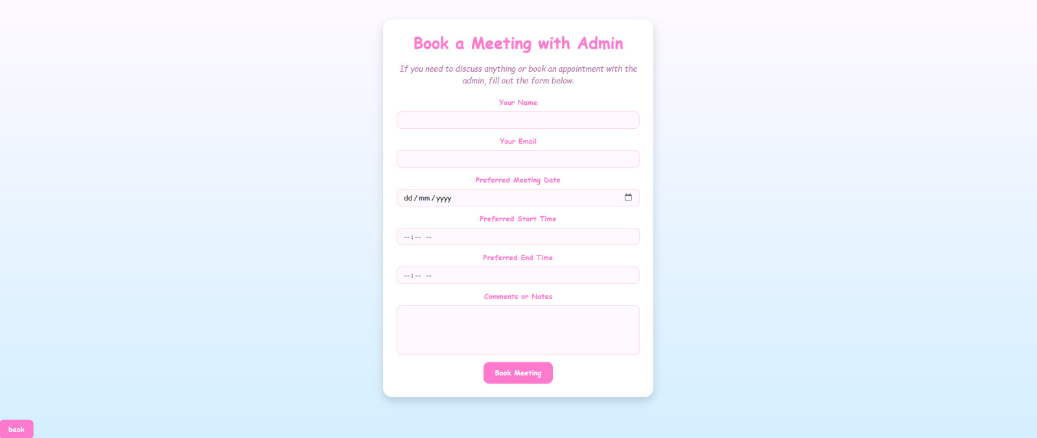
TO BOOK VENUE

Slide 17
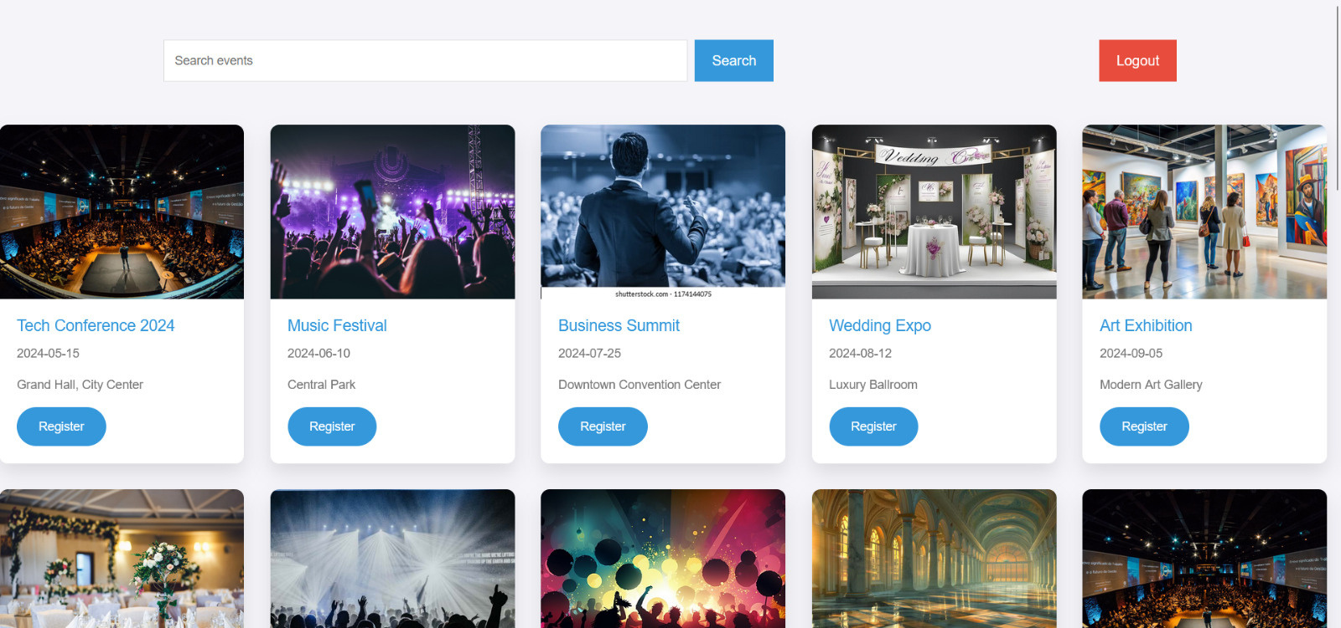
BOOKINGS

Slide 18
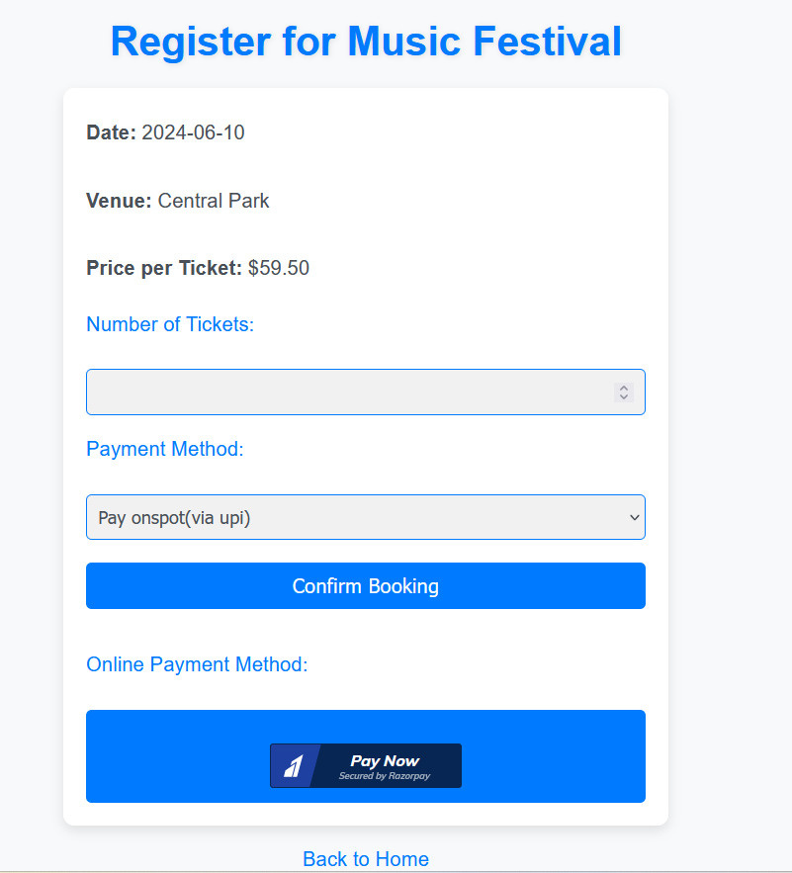
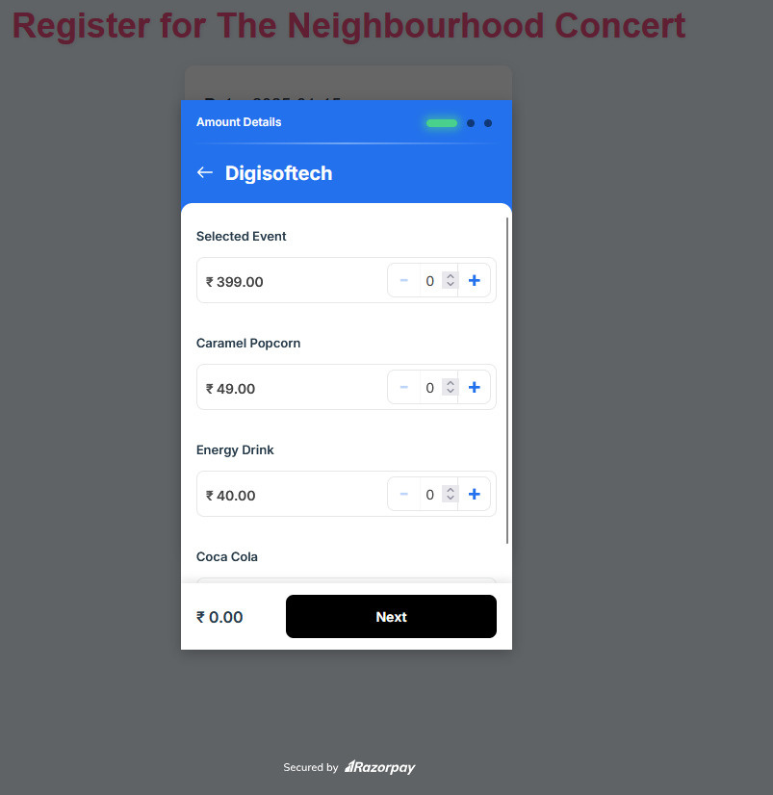
PAYMENT

Slide 19
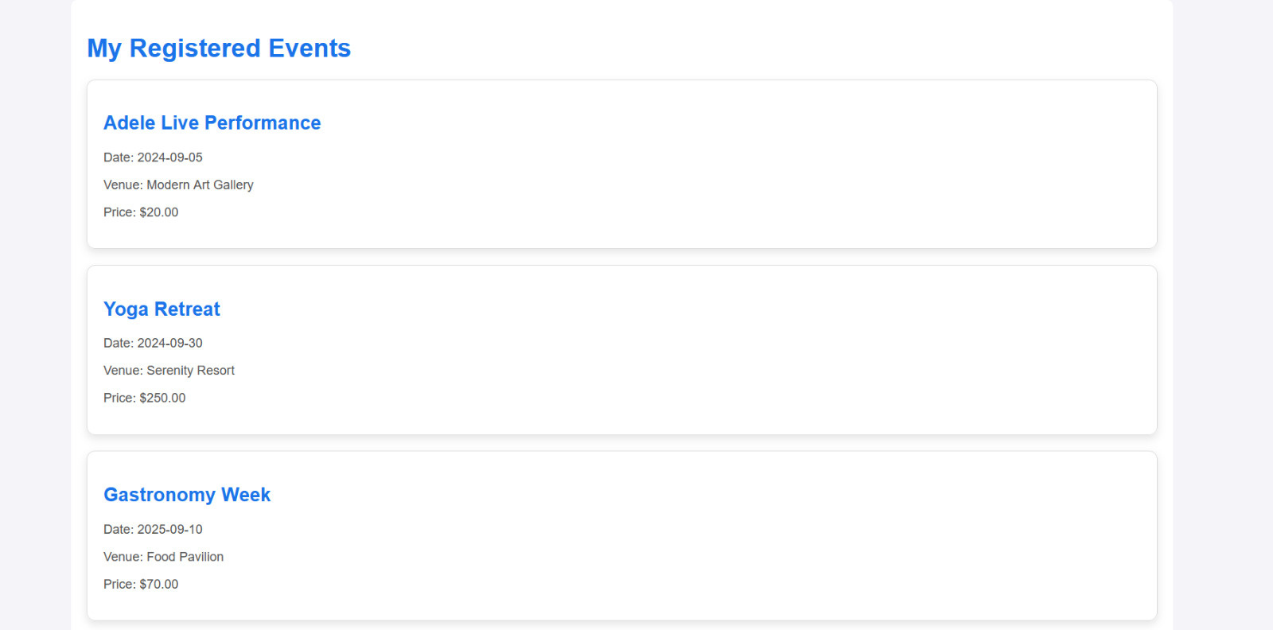
MY EVENTS

Slide 20
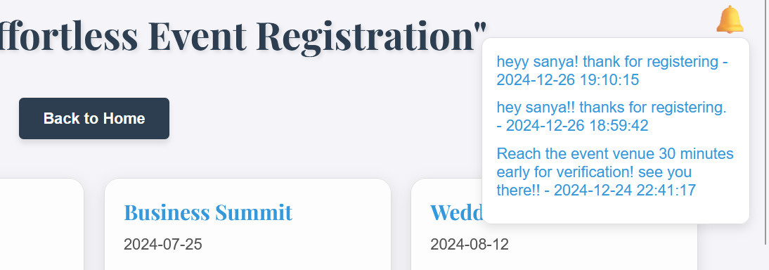
NOTIFICATION

Slide 21
ADMIN PORTAL

Slide 22
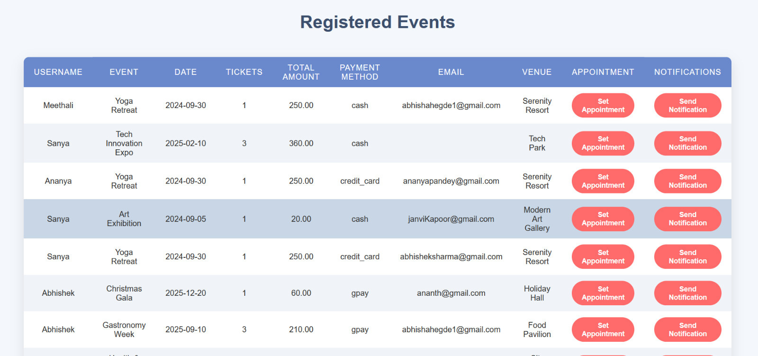
VIEW REGISTRED USERS

Slide 23
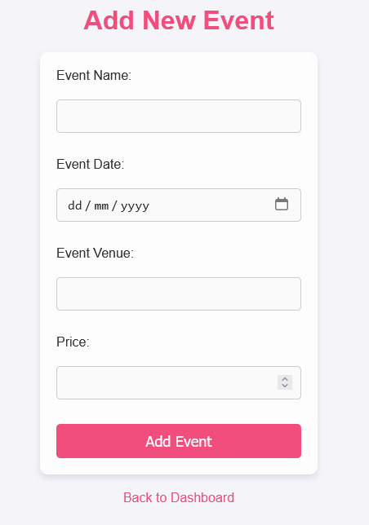
ADD NEW EVENTS

Slide 24
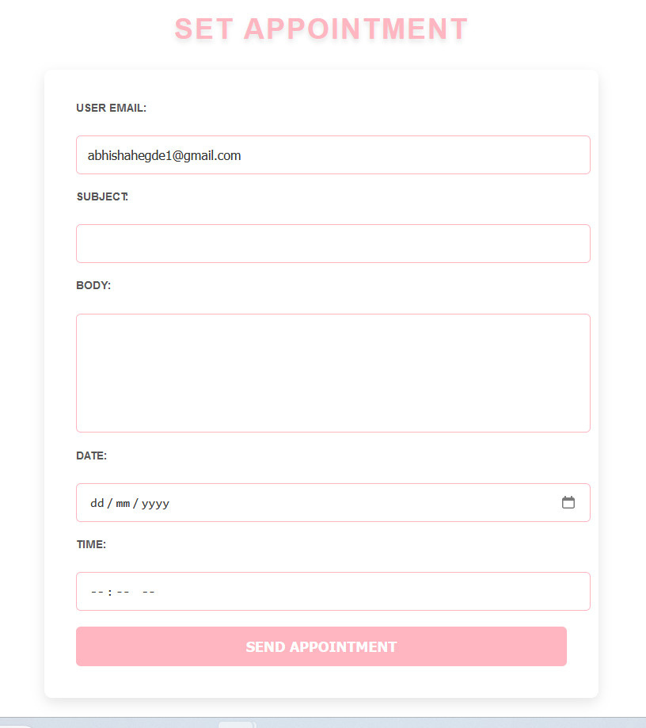
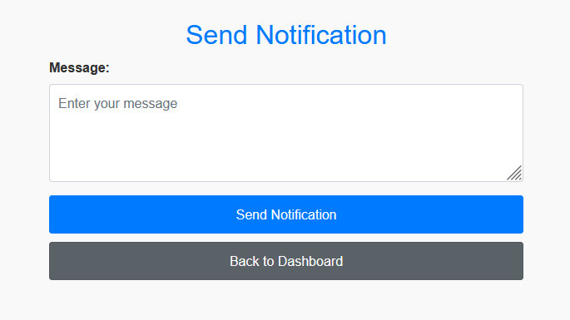
SET APPOINTMENT &
SEND NOTIFICATION

Slide 25
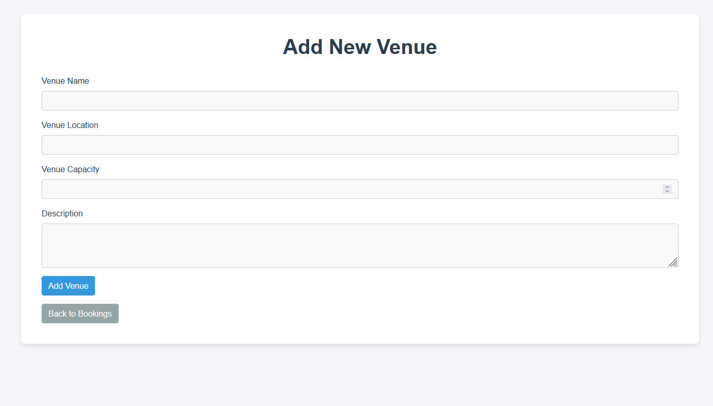
ADD VENUE

Slide 26

FUTURE SCOPE
Integration with third-party calendars (e.g., Google Calendar).
Enhancing accessibility through a mobile application.
Incorporate support for multilingual language into the interface.

Slide 27
CONCLUSION
The Event Management System streamlines event creation, ticket booking, and venue coordination, ensuring efficiency and accuracy. It offers a seamless, user-friendly experience, enhancing both organizer and attendee satisfaction.

Slide 28
THANK YOU !

